Slide 1
How to Control Where to Save New Records Templates and Rules From a Member Institution of a Network Zone Consortia
Yoel Kortick
Senior Librarian

Slide 2

Agenda
Introduction
The configuration and what it means (saving in the Network Zone)
The configuration and what it means (saving in the Member Institution)

Slide 3
Introduction

Slide 4
Introduction
When working in the metadata editor it is possible to save new
  Bibliographic records
  Bibliographic record templates
  Normalization rules
  Merge rules
  Indication rules.
In the case of working in a Member Institution of a Network Zone consortia it is possible configure whether these entities will be saved in the Member Institution or in the Network Zone.

Slide 5
Introduction
In this presentation we will see how each staff user can determine where these entities which he or she creates will be saved.
We will also see what the repercussions are of where (in which institution) the entities are saved.
Typically, the records are saved in the network zone and not in the institution, as this is the motivation of being part of a Network Zone consortium in the first place.

Slide 6
The configuration and what it means (saving in the Network Zone)

Slide 7
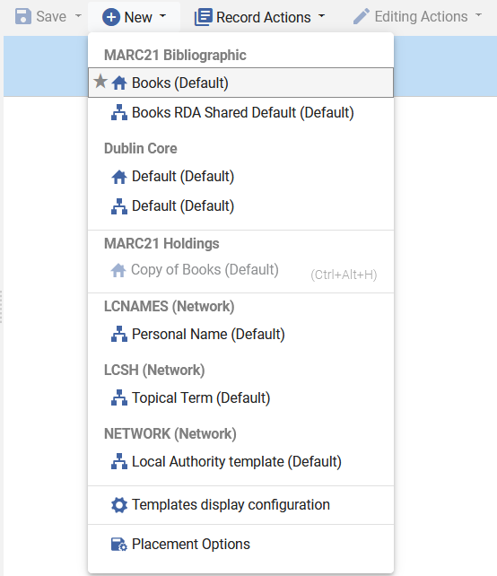
The configuration and what it means (saving in the Network Zone)
The configuration to determine where these entities are saved is accessed from within the metadata editor at “New > Placement Options”

Slide 8
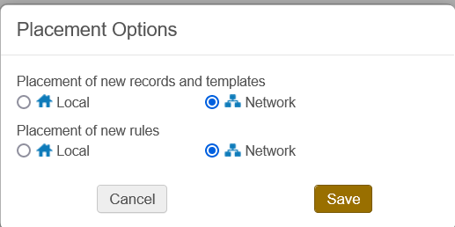
The configuration and what it means (saving in the Network Zone)
We are currently logged in to Member Institution “Open University” as user Alicia Chen and have configured that new records, templates and rules will be saved in the Network

Slide 9
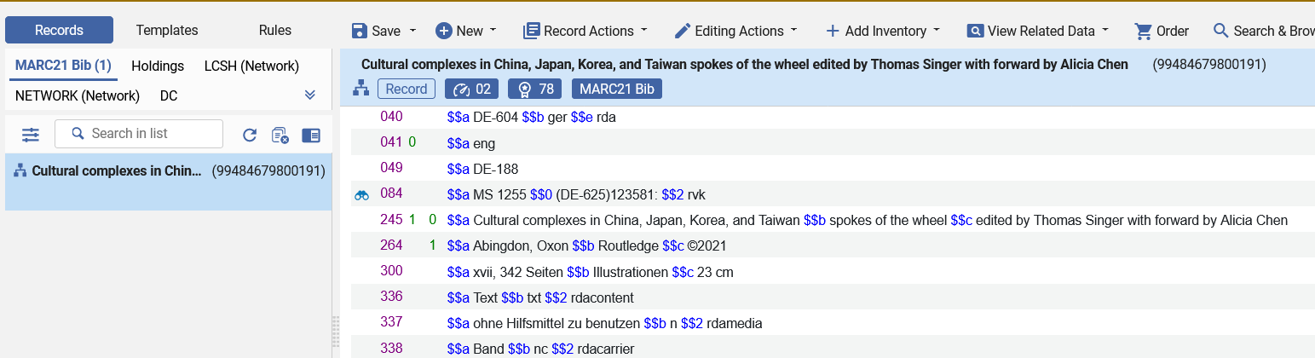
The configuration and what it means (saving in the Network Zone)
When Alicia Chen creates and saves a new bibliographic record in the Member Institution it is saved in the Network Zone.
Icon of the Network Zone

Slide 10
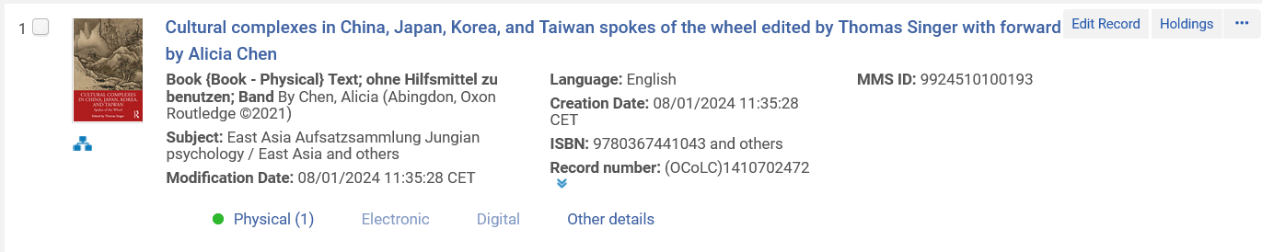
The configuration and what it means (saving in the Network Zone)
When Alicia Chen creates and saves a new bibliographic record it is saved in the Network Zone.
Icon of the Network Zone

Slide 11
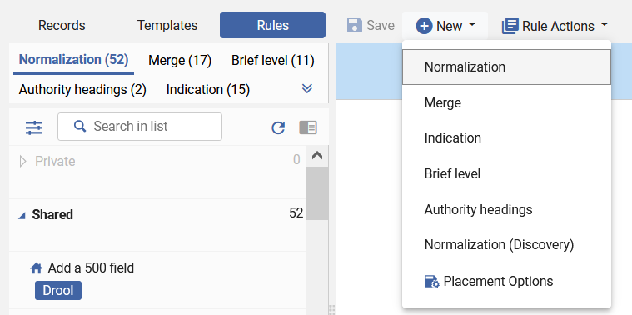
The configuration and what it means (saving in the Network Zone)
Now Alicia Chen will create a new normalization rule

Slide 12
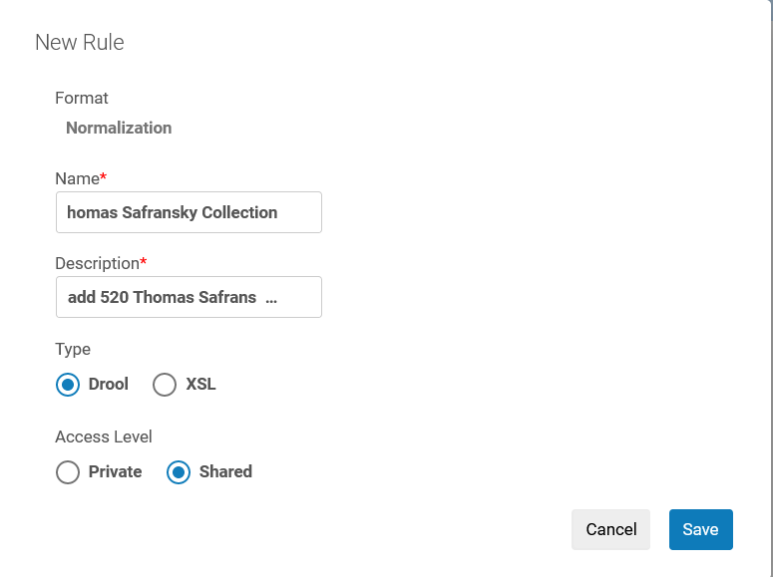
The configuration and what it means (saving in the Network Zone)
Now Alicia Chen will create a new normalization rule

Slide 13
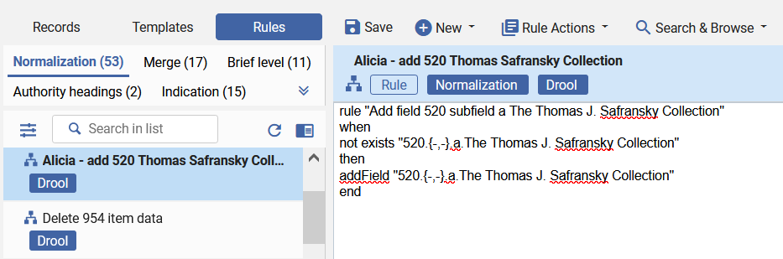
The configuration and what it means (saving in the Network Zone)
The rule created by Alicia Chen is in the Network Zone
Icon of the Network Zone

Slide 14
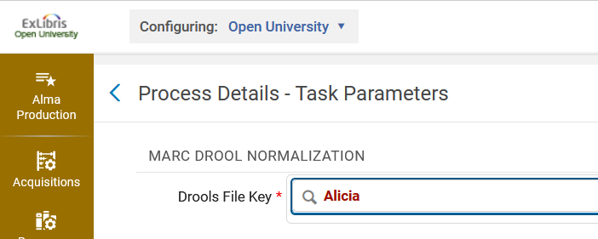
The configuration and what it means (saving in the Network Zone)
If a user now tries to create a normalization process in the Member Institution “Open University” (from where the normalization rule was created) the rule will not be found (because it was saved in the Network Zone)
Member Institution “Open University”
The rule is not found. It was called “Alicia - add 520 Thomas Safransky Collection”

Slide 15
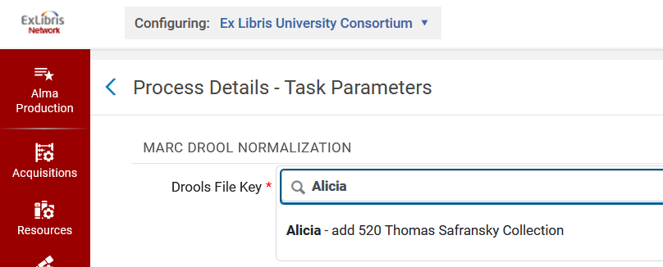
The configuration and what it means (saving in the Network Zone)
If a user now tries to create a normalization process in the Network Zone institution (even though the normalization rule was created in the Member Institution “Open University”) the rule will be found.
Network Zone institution
The rule is found. It was called “Alicia - add 520 Thomas Safransky Collection”

Slide 16
The configuration and what it means (saving in the Network Zone)
This means that if a user in a Member Institution defines to save rules in the Network Zone, then:
When he or she saves the rule, it will be in the Network Zone
It can then be added to a normalization process created in the Network Zone, but it cannot be added to a normalization process created in the Member Institution.

Slide 17
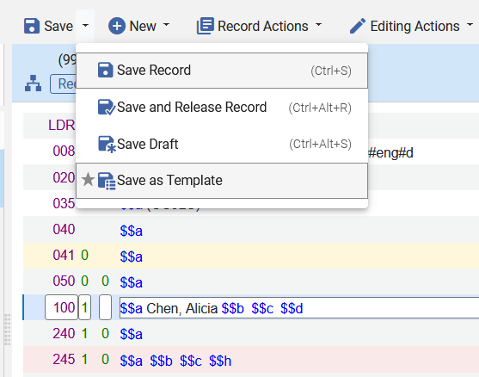
The configuration and what it means (saving in the Network Zone)
Now Alicia Chen will save a template

Slide 18
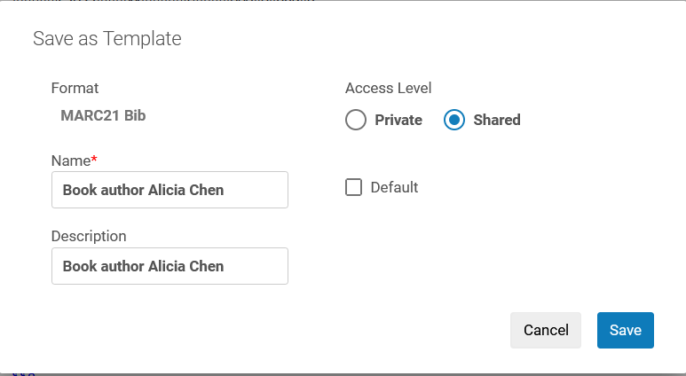
The configuration and what it means (saving in the Network Zone)
Now Alicia Chen will save a template

Slide 19
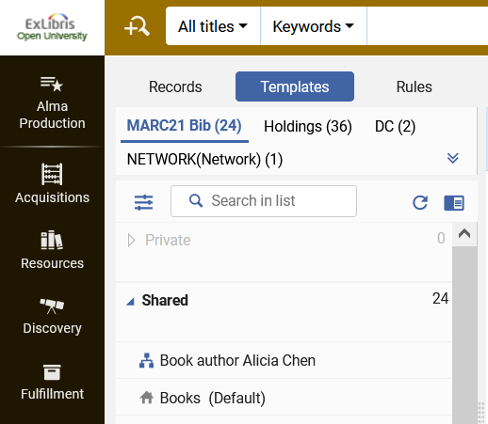
The configuration and what it means (saving in the Network Zone)
The template is saved in the Network Zone and visible from the Member Institution
Member Institution “Open University”
Icon of the Network Zone

Slide 20
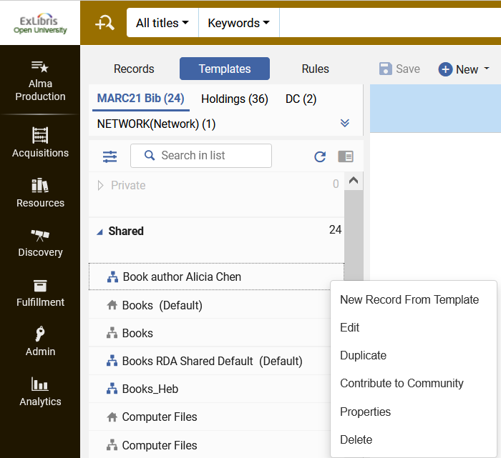
The configuration and what it means (saving in the Network Zone)
From within the Member Institution a new bibliographic record can be created from the template
Member Institution “Open University”

Slide 21
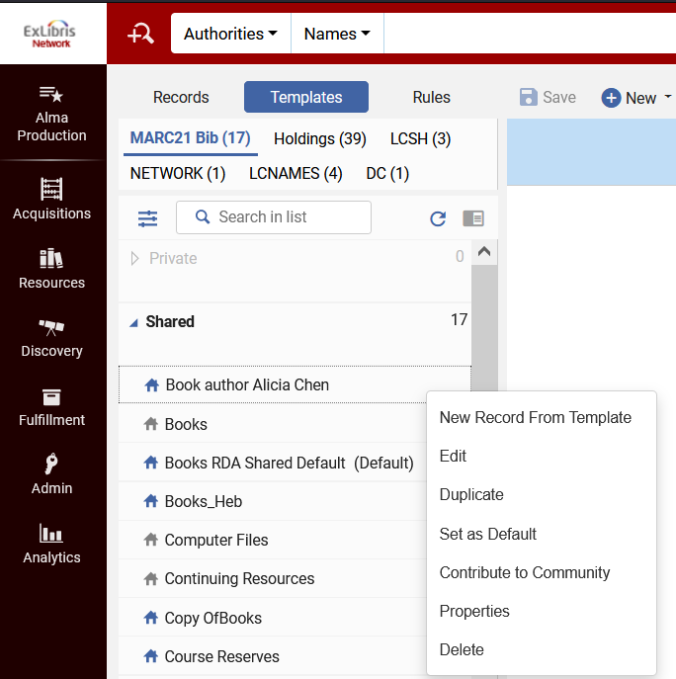
The configuration and what it means (saving in the Network Zone)
And from within the Network Zone a new bibliographic record can be created from the template
Network Zone institution

Slide 22
The configuration and what it means (saving in the Member Institution)

Slide 23
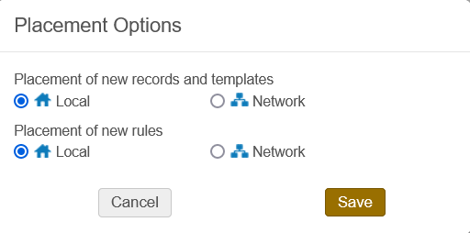
The configuration and what it means (saving in the Member Institution)
We are currently logged in to Member Institution “Open University” as user Caroline Devue and have configured that new records, templates and rules will be saved Local (in the Member Institution).

Slide 24
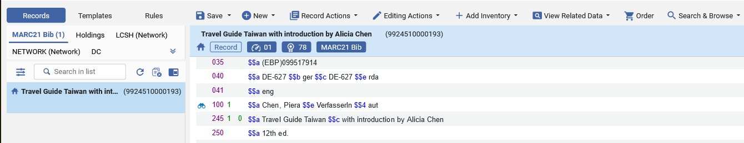
The configuration and what it means (saving in the Member Institution)
When Caroline Devue creates and saves a new bibliographic record in the Member Institution it is saved in the Member Institution.
Icon of the Member Institution

Slide 25
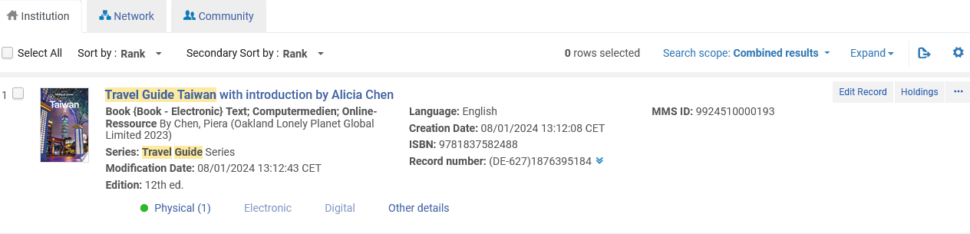
The configuration and what it means (saving in the Member Institution)
When Caroline Devue creates and saves a new bibliographic record it is saved in the Member Institution.
No icon of the Network Zone

Slide 26
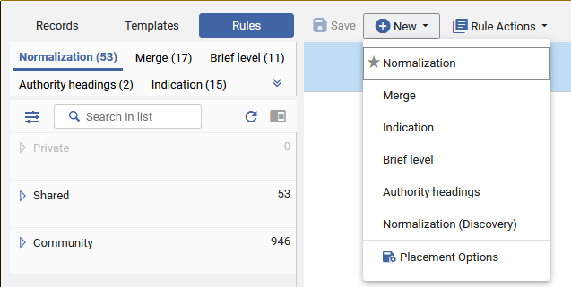
The configuration and what it means (saving in the Member Institution)
Now Caroline Devue will create a new normalization rule

Slide 27
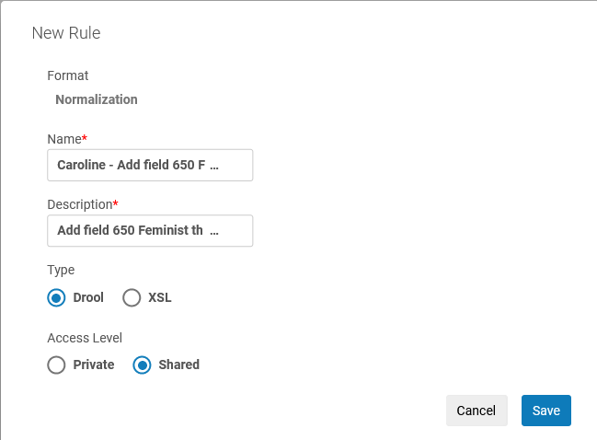
The configuration and what it means (saving in the Member Institution)
Now Caroline Devue will create a new normalization rule

Slide 28
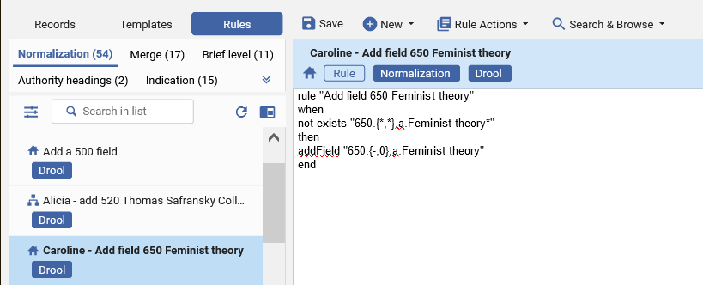
The configuration and what it means (saving in the Member Institution)
The rule created by Caroline Devue is in the Member Institution
Icon of the Member Institution

Slide 29
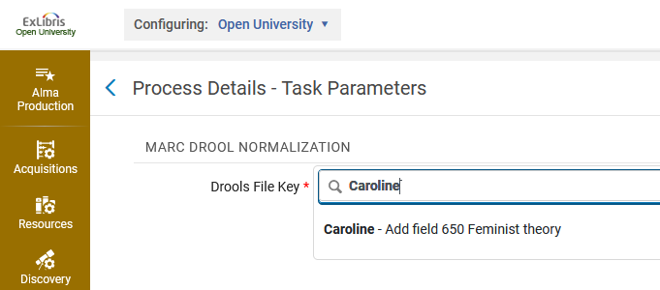
The configuration and what it means (saving in the Member Institution)
If a user now tries to create a normalization process in the Member Institution “Open University” (from where the normalization rule was created) the rule will be found (because it was saved in the Member Institution)
Member Institution “Open University”
The rule is found.

Slide 30
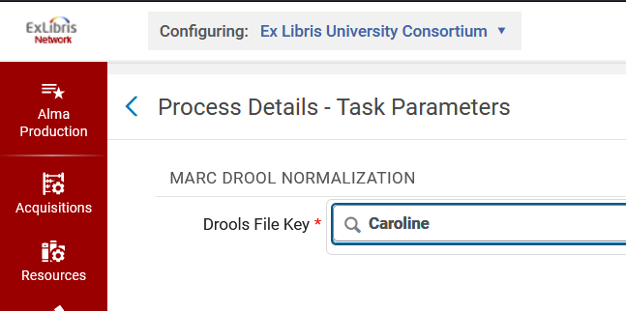
The configuration and what it means (saving in the Member Institution)
If a user now tries to create a normalization process in the Network Zone institution (even though the normalization rule was saved in the Member Institution “Open University”) the rule will not be found.
Network Zone institution
The rule is not found. It was called “Caroline - Add field 650 Feminist theory”

Slide 31
The configuration and what it means (saving in the Member Institution)
This means that if a user in a Member Institution defines to save rules in the Member Institution, then:
When he or she saves the rule, it will be in the Member Institution
It can then be added to a normalization process created in the Member Institution, but it cannot be added to a normalization process created in the Network Zone Institution.

Slide 32
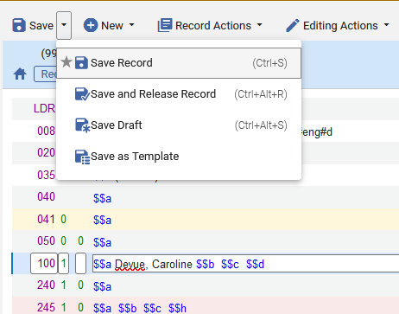
The configuration and what it means (saving in the Member Institution)
Now Caroline Devue will save a template

Slide 33
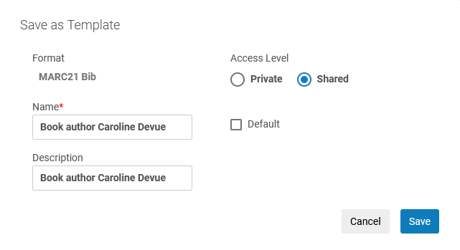
The configuration and what it means (saving in the Member Institution)
Now Caroline Devue will save a template

Slide 34
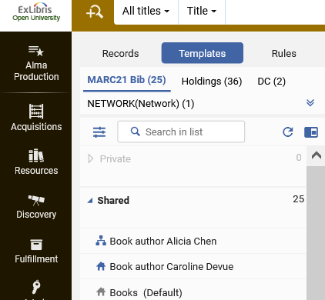
The configuration and what it means (saving in the Member Institution)
The template is saved in the Member Institution and visible from the Member Institution
Member Institution “Open University”
Icon of the Member Institution

Slide 35
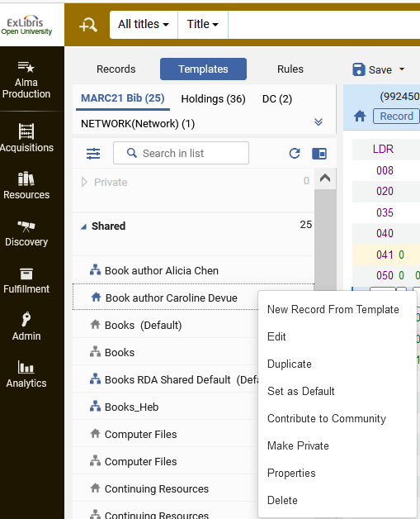
The configuration and what it means (saving in the Member Institution)
From within the Member Institution a new bibliographic record can be created from the template
Member Institution “Open University”

Slide 36
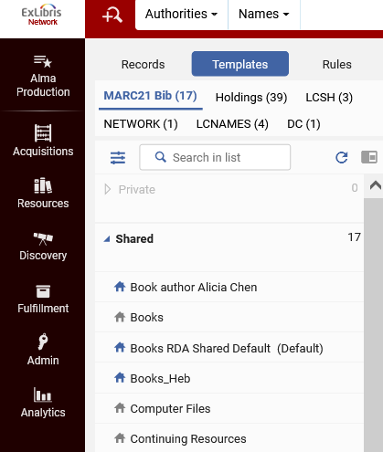
The configuration and what it means (saving in the Member Institution)
And in the Network Zone Institution the template does not appear.
Network Zone institution
The template “Book author Caroline Devue” does not appear

